Slide 1
Module 2: Introduction to ALP
Dr. P. Nirmala
Assistant Professor (SG)
SENSE, VIT

Slide 2
Editor
- An editor is a program which allows the creation of a file to write the assembly language statements for the program. - The editor stores the ASCII codes for the variables and values in successive RAM locations. - The typed program, which is called the source file is saved in the hard disk. The file extension is ‘.asm’.

Slide 3
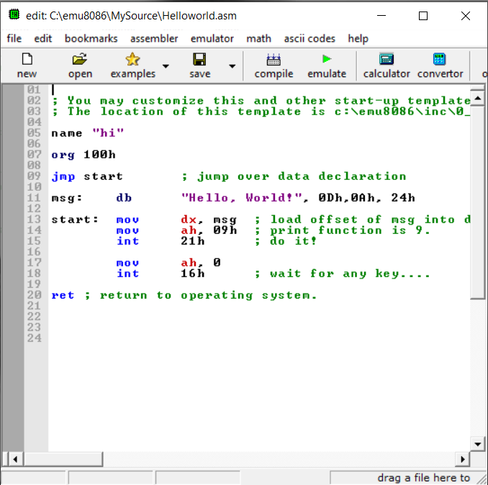
Editor

Slide 4
Assembler
Translates the assembly language instructions to corresponding binary codes.
When the assembler is done, it reads the source file of the program from the disk where it has been saved.
The assembler first determines the named variables, the offset of labels et., and stores them in a symbol table.
In the second pass through the source program, the binary code of for each instruction is produced and the calculated offset labels are inserted.
The assembler then creates 2 files in the hard disk. The first one is the object file with extension ‘.obj’.
The second one is called the assembler list file with extension ‘.lst’.

Slide 5
Linker
A linker is a program used to join several object files into one large object file.
The linker produces a link file that contains the binary code for all the modules in the program.
It also creates an address map file that contains the address information about the linked files. This has the extension ‘.exe’.

Slide 6
Locater
A locator program is one that assigns specific address of where the segments of the object code are to be located into memory.
IBM PC Disk Operating System (DOS) has a locator on called EXE2BIN. It converts ‘.exe’ file to ‘.bin’ file which has the physical addresses.

Slide 7
Debugger
It helps to load the object file into the system memory in order to execute, troubleshoot or debug the program.
It allows to look at the contents of the memory locations and registers after the program is run.
It also allows the users to make changes to the registers and memory locations and rerun the program.
Users can even stop the execution after each instruction and check for errors.
A breakpoint can be set at any point in the program. The debugger runs the program till that point and stop the execution.

Slide 8
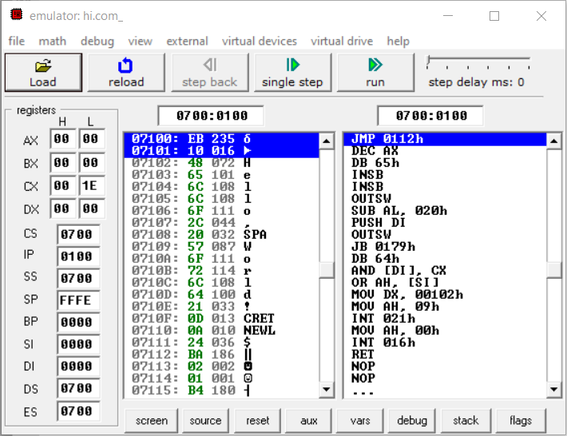
Debugger

Slide 9
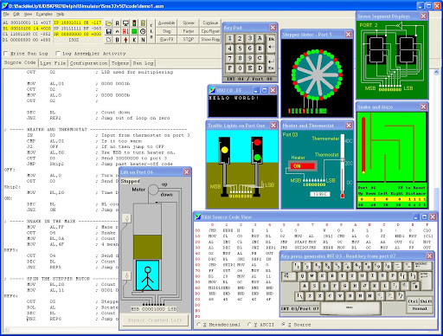
Simulator
Source:
https://www.google.com/url?sa=i&url=http%3A%2F%2Fwww.softwareforeducation.com%2Fsms32v50%2F&psig=AOvVaw2VUXxnVmQLji3_DyqzMGlS&ust=1592720692080000&source=images&cd=vfe&ved=0CAIQjRxqFwoTCJi146bhj-oCFQAAAAAdAAAAABAN, Accessed on 20 June 2020, 11:57 AM.

Slide 10
Emulator
An emulator is a mixture of hardware and software.
It is used to test and debug the hardware and software of an external system.
For eg., prototype of a microprocessor based instrument.
Part of the hardware of an emulator is a multiwire cable which connects the host system to the system being developed.

Slide 11
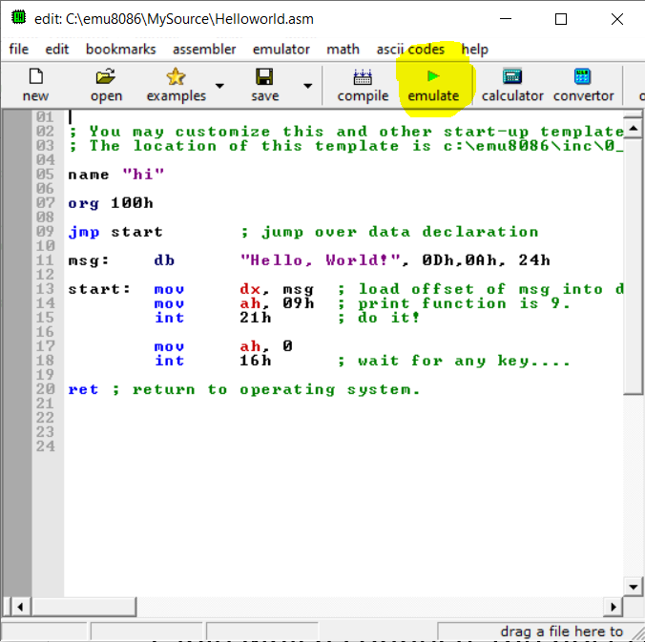

Slide 12
Weblinks
https://www.researchgate.net/publication/221195460_An_Assessment_Tool_for_Assembly_Language_Programming
https://www.tutorialspoint.com/embedded_systems/es_tools.htm

